Slide 1

E V O L V E I N N O V E & C O .
E M P O W E R E D B Y I N N O V A T I O N
Evolve Innove & Co. was founded in 2020 August, which deals in innovative product based solutions to solve the common life gaps in the society. Our consistent efforts in doing innovations makes us unique from the market's rat race.
Address:- HX-73 E7 Extension Area Area Colony Bhopal,462016 (M.P.)
Email-evolveinnove.123@gmail.com

Slide 2

R E M O T E P O P U L A T I O N A N A L Y S E R
P R O D U C T - " T h e p e r f e c t h o u r "
Our latest project is on developing an ecosystem for getting remote access on the amount of crowd in a premise like- Malls |Hotels |Social-Gathering |Halls | and similar other sectors. To execute it we are doing innovative efforts to build a product named as-"The Perfect Hour" which will be a combination of a website and app with our previous product named as-"COVID-GUARD". We have also filed a patent for COVID-GUARD.
Address:- HX-73 E7 Extension Area Area Colony Bhopal,462016 (M.P.)
Email-evolveinnove.123@gmail.com

Slide 3


Problem
01
At present, no such system exists for getting remotely the data of people in a campus
02
The spread of virus is increasing alarmingly especially in public places,even irrespective of pandemic hours, the time of people gets wasted due to rush hours and improper mob management in such places.
(Chance for the survival).
03
The end user doesnot have any proper medium(website or app) to manage his visiting hours(through pre bookings).

Slide 4
Problem
04
Count total visitors and visitors to each area or exhibit
05
Monitor occupancy: which rooms are busiest at the moment
(Chance for the survival).
06
See the length of time people pause at exhibits & find peak visitor times
07
Deploy staff more effectively & Intelligently schedule maintenance

Slide 5

Solution
01
Creating an innovative product which is compact and portable
02
On second stage, combine it with hardware to give real-time data on an app or as per consumer demands.
03
Giving remote access to data through android app or other means thereby managing the crowd visiting hours and therby creating a "COVID free zone" and saving the time.
(Faith factor of our company)

Slide 6
Value Proposition
Our company is providing an innovative solution to built faith in our customers by giving a predictive data of a crowd of people in a premises through a techno co- ordination between software and hardware.
The product provided by us will be tested before delivery, and their will be 1 year warranty(extendible) for our products as well as 6 months free service.
Their will also be flexibility towards improvements and changes as per the customer demands.
Building a website(at initial) and thereby an app to remotely
view the data of people in a campus.

Slide 7
Value Proposition
With the co-ordination of hardware and software, providing an analysis for "the perfect hour" to a visitor so that he can visit and pose no exposure to crowds.
The website will be used for giving a pre-booking options to user in campus(which agree) to make it more functional.
Flashing ads of our consumers to market their business in-front of normal public.
Giving innovative advertisement options to our consumers to
make their shop or hotels a market gatherer, on trends. Providing loyal services to the consumers, and keeping it as our top-priority.

Slide 8
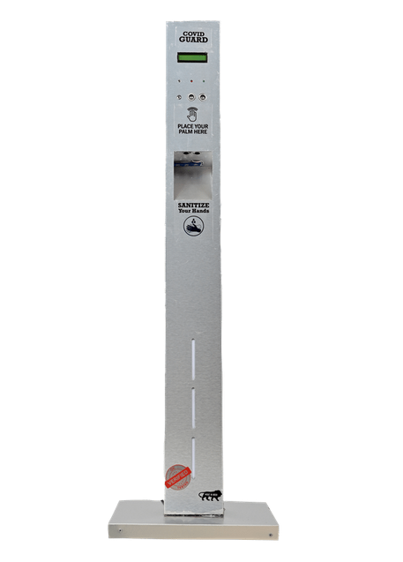
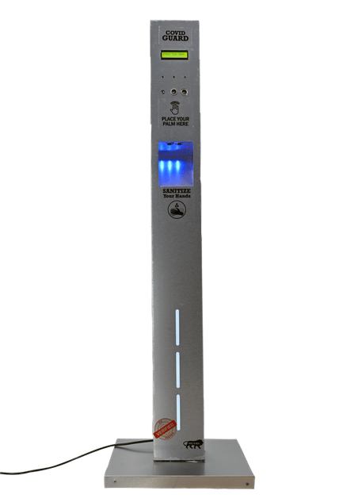
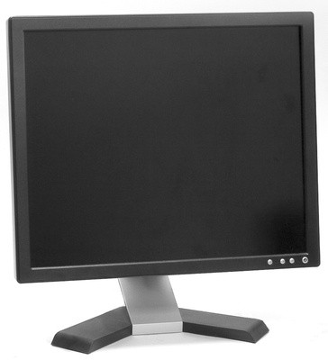
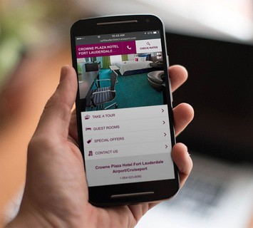
How it Works
Part-A The pics shown give an idea of collecting data from targets through sensors of the people entering inside a premise.
After that, the data will be processed by the C.P.U. unit inside
The data given by CPU will then be converted into an animation(if required), else will be displayed on a screen.
The same data will be able to display on the andriod app which the users can adapt for awareness(second stage only).
The buzzer system inbuilt, will give real-time alerts for suspects, and can display the data to customers(if required), hence they will get some predictions about the virus in your hotel or campus, thereby the task will be achieved.

Slide 9
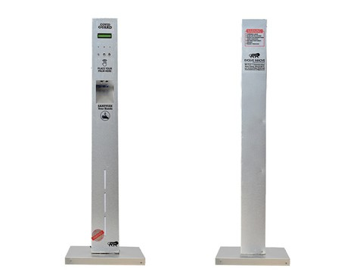
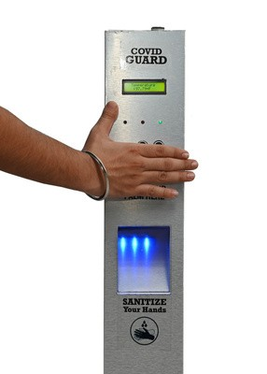
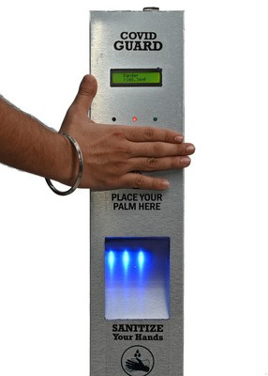
How it Works
Part-B
The pics shown give an idea of collecting data from
targets
When the palm is brought infront of ultrasonic sensor, as per shown position the temperature is taken by MLX90614 sensor.
The temperature is displayed on the screen with a green indicator and a single beep(if safe), else temperature is shown with red led including a long beep alarm.
At the middle, is the sanitizer dispenser, which gives a prescriptive amount of sanitizer, when a hand is placed under it, with delay time of 3 seconds.
If required, the data of temperature taken can be given on website, to have an idea of the highest temperature got in a crowd, thus to prevent it from spreading the virus.

Slide 10

Financial Projections
EXPENSES :
RnD COST= ₹20,000
(This includes the cost for doing experiments on Industrial Sensors.)
Part-A
Raw Material Costs = ₹9500+₹8000
Outer Body= ₹1500
Components = ₹5000+₹8000(hologram)
(NODE MCU(1), MCU Atmega 328P(1), Temperature Sensor MLX90614(1), Ultrasonic Sensor(4), LCD 20*4(1), Solenoid Valve(1),( Power Supply, LED Indicator(3), Relay, Hologram(1),Wires(4m), IC Jacks,Other small equipents ).
PCB = ₹3000 (for 50 PCB's or ₹60 per product)
***The raw material cost here is for per product (6560) for advance-1 stage

Slide 11
Financial Projections
EXPENSES :
Website Development = ₹10,000(tentative)
().
App development=₹yet to decide(in second stage)
().
Advertisement & Marketing=₹5,000(for 3 months)
().
Initial Production Cost=₹45000
[For testing in 5 premises at a start with basic product=₹4500*10=₹45000(2 product per premise)]
Company Registration= ₹20000
[Name Approval (RUN),Digital Signature Certificate (DSC) Class-2,DPIN,Incorporation Certificate, Stamp Duty,PAN & TAN,MSME Registration,GST Registration,DPIIT.]
Part-B

Slide 12


Financial Projections
EXPENSES :
Part-A
R-n-D =₹20,000
Raw-Material=₹17500(+)
=₹37,500
Part-B
Website Marketing Initial Product
=₹10,000
=₹5,000
=₹45000
Company Registration=₹20000(+)
=₹80,000
***Total=₹65000+₹37500=₹1,17,500 (excluding app charges)

Slide 13
Financial Projections
REVENUE :
B2C ORDERS
(Hotels,Malls,Public-places,Local-transports(buses),Hospitals,Parks,Musems,Community Halls,etc)
SERVICE VISITS
MATERIAL IN REPAIRS
B2B BULK ORDERS
FRANCHISE

Slide 14

Competitors
1. Maven Stat:-
The Data they provide is:
Number of incoming, outgoing and currently inside visitors Distinguish employees from visitors for more accurate analysis Outdoor systems that measure traffic in front of the retail store Identifying busiest days and when power hours
Managers to optimize their sales performance, to improve sales efficiency, conversion and customer service
Retailers to improve their business planning and forecasts
Making brighter business decisions by identifying and analyzing trends through the given systematic statistics information

Slide 15

Competitors
1. Maven Stat:-
The Data they provide is: (continued)
Making analysis and assessment of marketing and advertisement campaigns
Once the number of customers inside the store (at any given time of the day) is clear, managers could easily improve business and always have the right number of employees to give the best customer service
Technology :- https://youtu.be/Q9xjlNfgk0c
Based on video analysis, the demographic analysis system is an unlimited, easy-to-use platform that is accessible to all customers who have Internet connectivity.

Slide 16
Competitors
1. Maven Stat:-
Technology :- (continued)
The guaranteed precision of the solution is over 95% in determining gender and ethnicity and deviation up to 3 years from the actual age, even at peak load of tens of thousands of visitors daily.
Ability to integrate with any type of sales management systems, external databases and BI analytics tools
Other links-https://youtu.be/XN7ru38vqG8 Other links-https://youtu.be/O0nbl8GXdgU
Office:- in Bulgaria and U.K.

Slide 17



Competitors
2. Retail Sensing
(People Counting Systems) :- Similar company
Office :-
10 Stocks Street, Manchester, M8 8QG, UK. Tel: +44 (0)161 839
6437. Fax: +44 (0)161 833 2190
Technology :-
Using IP phones and CCTV cameras https://youtu.be/1fjA-PLUCcw

Slide 18

Competitors
3. Irisys :-
Description :
The most advanced, anonymous people counter in the world with unrivaled count accuracy.
Impressive features such as staff detection, dwell time measuring and the ability to connect multiple units to cover wide openings enable this IoT device to help smart retailers go beyond people counting and optimise their customer experience.
Link-https://youtu.be/lKbtTWv6_iI

Slide 19

Competitors
3. Irisys :-
Solutions:
People Counting Occupancy Monitoring Occupancy Analytics Smart Buildings Queue Management
Office: -
InfraRed Integrated Systems Ltd (Irisys)
Park Circle Tithe Barn Way Swan Valley Northampton NN4 9BG United Kingdom

Slide 20
Sales & Marketting
The various stages are as follows: -
SOCIAL MEDIA
THROUGH PAID ADDS, FORWARDING POSTS
LEGACY MARKETS
PROVIDING FREE DEMOS, CONTACTS WITH WHOLESELLERS OF SURGICALS.
TV ADDS
IN HIGHER STAGES EDUCATING PEOPLE
ABOUT THE INNOVATION, WITH AGGRESSIVE REPEATS

Slide 21
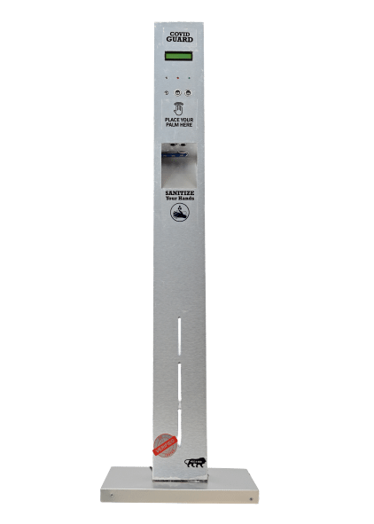
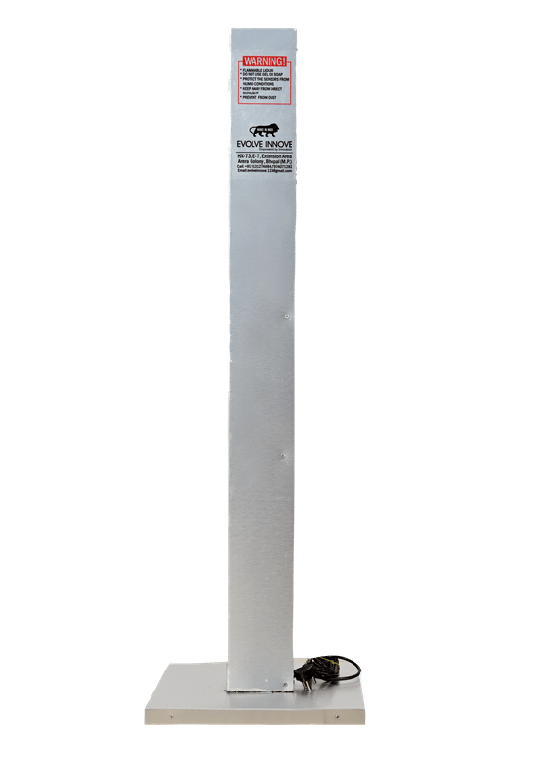
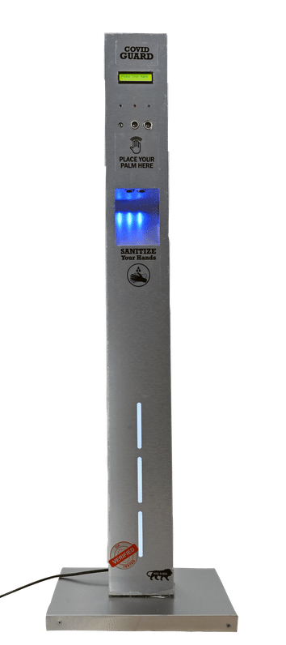
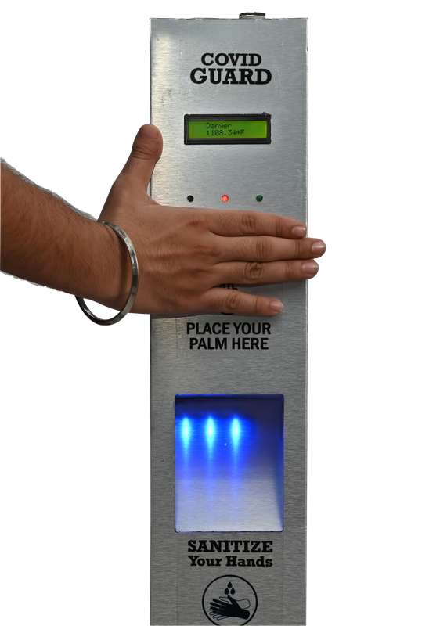
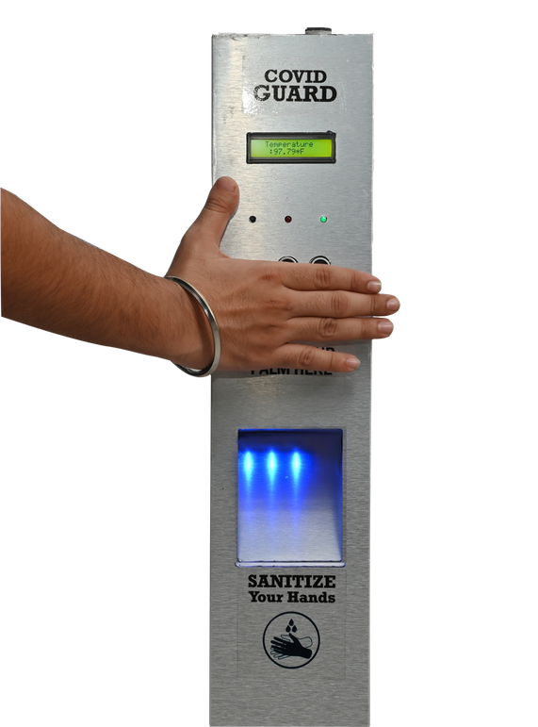
Product Pics
of COVID-GUARD are as follows: -

Slide 22
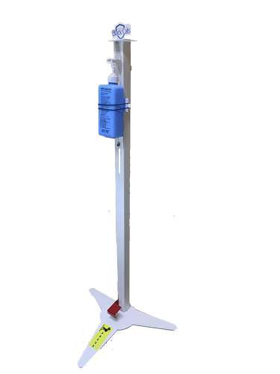
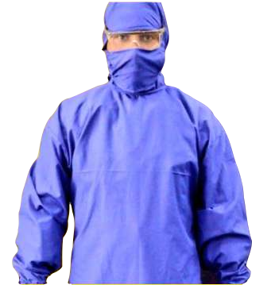
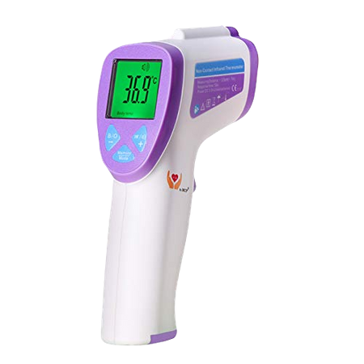
Market - Stand
=
+
+
SANITIZER STAND=
₹₹₹
STAFF=
₹₹₹
(PER MONTH)
COVID GUARD=
₹₹₹
THERMAL GUN=
₹₹₹

Slide 23
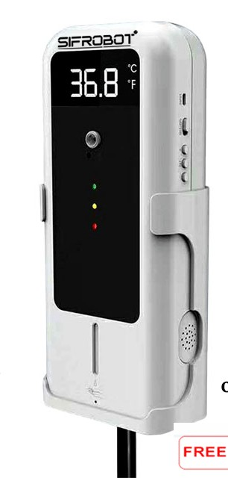

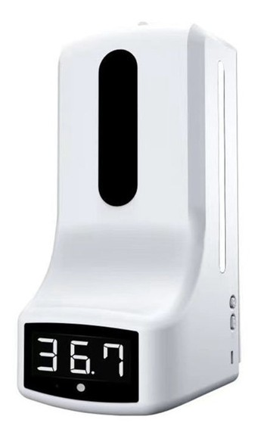
Competitors
=
;
;
Price= ₹5,000 (only temperature unit)
Price= ₹10,000
Price= ₹7,000
COVID GUARD
(on-time with warranty)

Slide 24
Pricing
The various pricing stages are as follows: -
₹6,500
BASIC
(Population counter+ Sanitizer Dispenser)
₹9,500
ADVANCED-1
(Population counter+Sanitizer dispensr+ Temperature Scanner)
₹16,000
ADVANCED-2
(Population counter+Sanitizer dispensr+ Hologram based advertisement unit)
₹20,000
PREMIUM
Population counter+Sanitizer dispensr+ Temperature Scanner+ Hologram based advertisement unit)
*The product from advanced-1 stage and thereon will have a warranty of 1 year

Slide 25


Where to Purchase
As illustrated on a map our product and service will be available for sure.

Slide 26
Proof
“I love this product. What a lifesaver!” - Anupam Chouksey Sir
“This product changes the game for real." - Dolraj Gaire (Sagar Gaire)
Shared some customer testimonials, case studies, expert quotes, that make our product & service worth trusting
and purchasing.
“Why have I not heard about this before?" - Jitender Sir (Baapu Ki Kutiya)
"Free shipping for a year is incredible!" - Atul Sir (Narmada Hospital)

Slide 27
What's Happening Next
As per the current situation, our product can help in someway to once again- gain your business on tracks. Further it will be a good innovative, fresh way to built trust in your customers.
For a next upgrade we are planning to have a rating scale on many global apps, like Google, for hotels and others that will get our product installed

Slide 28
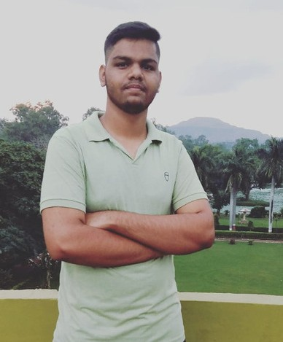
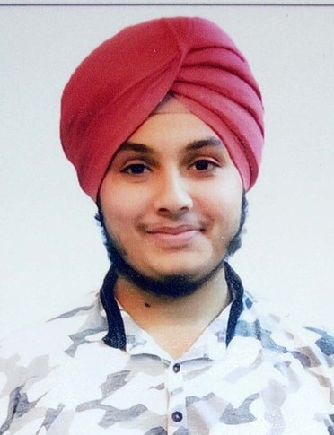
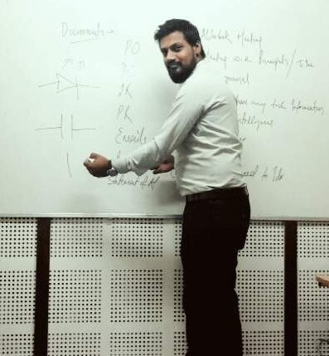
The Team
Prashant Tiwari
CEO,Founder
Amanpreet Singh
Bhalla
Co-Founder, Creative Director
Arpit Soni (from ROBONAUTS)
Head of RnD & Hardware

Slide 29
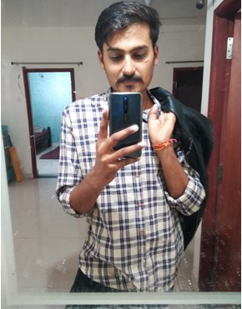
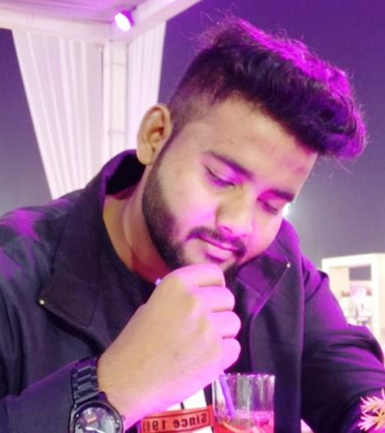
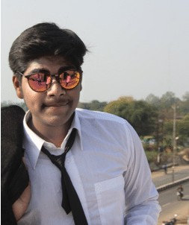
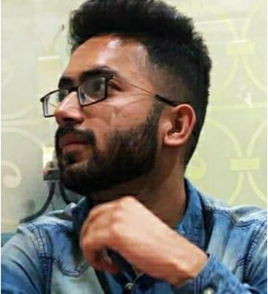
Team-Leaders
Rajkumar Choudhary (A.P.I. & backend expert)
Skills: Python front end
Django
Tabish (Website-frontend)
Skills: Graphic Designing,UI/UX
Priyesh Mandlekar (Digital-Marketing) Skills: Graphic Designing.
Sagar Jeevtani (Sales-&-Marketing)
Skills: Problem solving &Team work

Slide 30
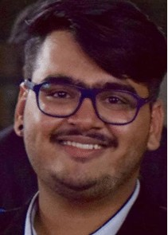
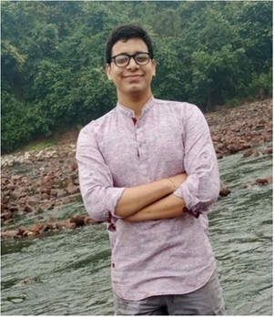
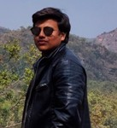
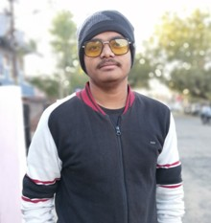
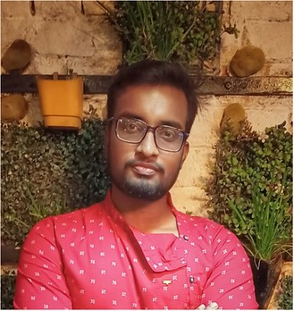
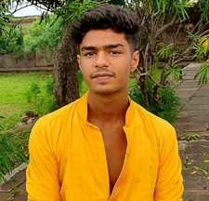
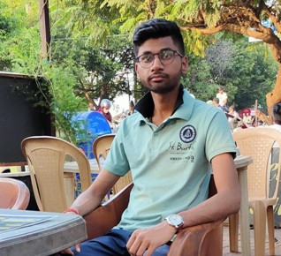
Creative-Interns
Dev Manocha
(Team-Sales-n-Marketing)
Ankul Kumar Singh
(Team-Sales-n-Marketing)
Saubhagya Agrawal
(Team-Sales-n-Marketing)
Ayush Gupta
(Team-Sales and Marketing)
Shubham Jaiswal
(Team-Hardware)
Gagan Prajapati
(Team-Website Developers)
Arpit Ghura
(Team-Website Developers)

Slide 31
Call to Action
We request our customers to have a look on a prototype for more clarification and then get our quotation accepted for their chosen plan.

Slide 32

Contact Us
+917974071282,+91 9131274694
evolveinnove.123@gmail.com

Slide 33


Free Resources
Get in touch with us on facebook and instagram...

